Slide 1
Public Issue vs Private Placement of IPOs
By Group 5.
Group Members:
Ashish Birla (17AG36003)
Alok Kumar (18IM10004)
Nikhil Mantri (17AE3FP06)
Yaksh Patel (17ME3FP01)

Slide 2
Contents: 1. Public Placement of IPOs 2. Process Overview 3. Example 4. Private Placement of IPOs 5. Example 6. Difference between the two

Slide 3
Public Placement of IPOs

Slide 4
Public Placement of IPOs
An initial public offering (IPO) refers to the process of offering shares of a private corporation to the public in a new stock issuance. Public share issuance allows a company to raise capital from public investors.
The transition from a private to a public company can be an important time for private investors to fully realize gains from their investment as it typically includes share premiums for current private investors.
Meanwhile, it also allows public investors to participate in the offering.

Slide 5
Public Placement of IPOs
When a company reaches a stage in its growth process where it believes it is mature enough for the rigors of the regulations along with the benefits and responsibilities to public shareholders, it will begin to advertise its interest in going public.
Roadshow : A roadshow is a series of presentations made in various locations leading up to an initial public offering (IPO). The roadshow is a sales pitch or promotion made by the underwriting firm and a company's management team to potential investors before going public.
An IPO is a big step for a company as it provides the company with access to raising a lot of money. This gives the company a greater ability to grow and expand. The increased transparency and share listing credibility can also be a factor in helping it obtain better terms when seeking borrowed funds as well.

Slide 6
Advantages of a Public IPO
Public companies can attract and retain better management and skilled employees through stock options.
According to Investopedia, IPOs can give a company a lower cost of capital for both equity and debt.
Disadvantages of a Public IPO
The risk that required funding will not be raised if the market does not accept the IPO price.
Strategies used to inflate the value of a public company's shares, such as using excessive debt to buy back stock, can increase the risk and instability in the firm.
Huge upfront costs are involved in launching the IPO.

Slide 7
Overview of the process
Selection of Underwriter(s)
Criteria :
Industry Expertise
Reputation
Distribution Network
Due Diligence and Regulatory Filings
Underwriting Arrangements:
Firm Commitment
Best Efforts Agreement
All or None Agreement
Red Herring Document
The Prospectus
Filing with SEBI & Stock Exchanges
Pricing
The issuing company and the underwriter decide the offer price and the number of shares to be sold
Issue is priced through following ways :
Fixed Price Issue
Book Building Issue.
Transition
The transition to market competition, starts 25 days after the IPO. During this phase, underwriters can give estimates regarding the earning and valuation of the issuing company.
Stabilization
It occurs immediately after the IPO. The underwriter creates a market for the stock after it's issued. It makes sure there are enough buyers to keep the stock price at a reasonable level.
Bidding Process
The window is of generally 3-5 days.
Share Allocation
Listing in the exchanges
Refund process

Slide 8
The story of Facebook IPO
The company founded by Mark Zuckerberg and his Harvard classmates resisted takeover attempts for years including a $ 75M Viacom offer and a $ 1B Yahoo! Offer.
In 2012, Zuckerberg finally decided to go public.
Facebook had a huge user base of 900 M people at the IPO time. Critical Questions By Investors:
How does Facebook make money?
How will Facebook impact mobile phones?
How will Facebook ads perform on mobile phones?
Advertisements was the major source of revenue for Facebook at that time and Advertisers used to come to Facebook due to its massive reach, high user management, targeted ads.

Slide 9
The story of Facebook IPO
Facebook had a 140% sale growth y-o-y from 2006 to 2011. It had a net income of 700 M dollars and an EBIT margin of 47%.
So initially Facebook was deciding on the price band of 28$- 38$ per share.
On the IPO day, Morgan Stanley, Facebook’s global coordinators for this deal suggested 38$ per share, very close to the suggested maximum price.
The company managed to sell 4.8 % of its stake via the IPO for $ 5B and its valuation rose to $ 104B.
But ironically, after the IPO, the company’s share price began to go down. By May 2012, it had gone down from 38$ to 25$, a fall of more than 30 %.
It further fell down to 19$ per share. Investors were very unhappy and some commentators termed the IPO as a fiasco.

Slide 10
The story of Facebook IPO
But the company based on its strong fundamentals and motivation, went on to progress.
By 2018, the share price became 184$ per share and as of today it is 278$ per share.
Conclusion : Though in 6 years, the share price became 4.5 times the IPO share price, but looking at it from an IPO perspective, 365 Careers states that it wasn't a successful one because the investors were not happy, the company could have sold the shares at a discounted price but they sold it at the highest possible price. This ultimately hurt the stock price for months and there were many investors who bought shares at 38$ and sold them at less than 26$ per share.

Slide 11
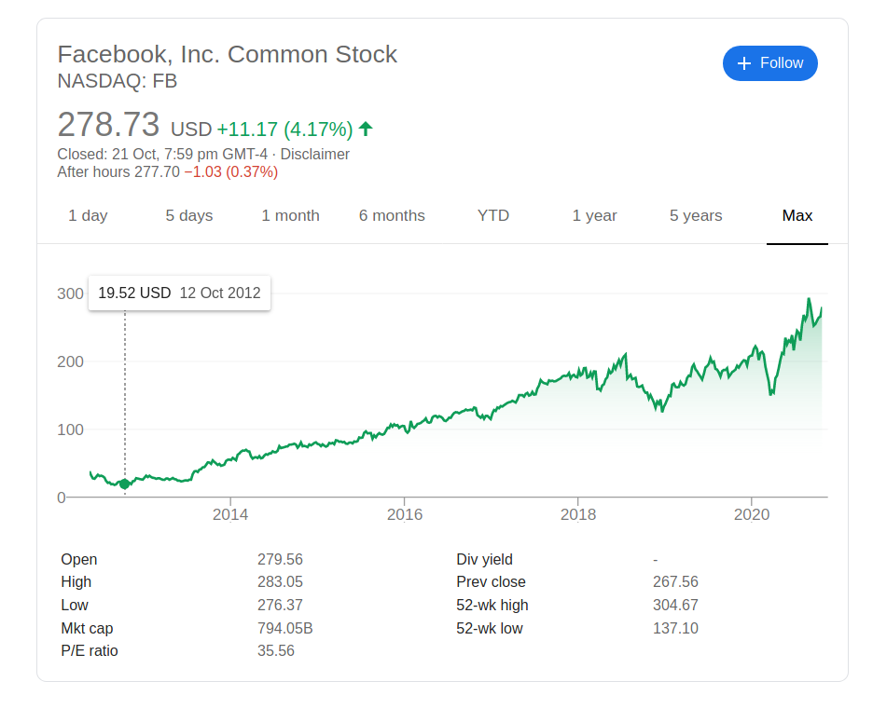
$ 38

Slide 12
Private Placement

Slide 13
Private Placements
Private Placement is a private alternative to issuing, or selling, a publicly offered security as a means for raising capital.
In a private placement, both the offering and sale of debt or equity securities is made between a business, or issuer, and a select number of investors.
Investors generally include banks, mutual fund companies, wealthy individual investors, insurance companies, etc.
Private Placements are exempted from registering with Securities and Exchange Commission.
Regulation D (also referred to as Reg D.) of the SEC act of 1933 after the market crash of 1929 provides an exemption from registration for private placement offerings.

Slide 14
Private Placements
Companies, both public and private, issue in the private placement market for a variety of reasons as follows:
Desire to access long-term, fixed rate capital
Diversify financing sources
Add additional financing capacities beyond existing investors (for eg., banks, private equity, etc)
Maintain confidentiality in case of privately held businesses

Slide 15
Types of Private Issues
Private Placement: The sale of securities to a relatively small number of select investors as a way of raising capital. This is a wholesale issue of securities to institutional investors by an unlisted company.
Preferential Issue: A private placement of securities by a listed company. Securities are issued to an identified set of investors which may include promoters, strategic investors, employees and such groups.
Qualified Institutional Placement (QIP): A private placement of securities by a listed company to a set of institutional investors termed as qualified institutional buyers is a QIP.

Slide 16
Effect on Share Price of a Company due to Private Placement
If a private company does private placement it doesn’t affect their share price since they are not publicly listed.
However, if a publicly listed company private placement leads to decline in the share price at least in near term.
The reason for decline in share price is due to the dilution of the ownership of existing shareholders in the proportion of the placement.
There might be exceptions in increase of share price (in long term) if company is planning to raise capital for a project which could provide extra returns and thus extra profits.

Slide 17
Private Placements Process
Deal Launch
The issue is offered to the investor to purchase; a decision must be made by a specific date.
Negotiations
Terms and issuance parameters are negotiated; legal documentation is solidified.
Information Gathering
The investor does their due diligence on the company, including reviewing financial statements, researching management and studying the company’s future opportunities in the market and their industry.
Investment Risk Analysis
An investor establishes a view of the issuer’s credit quality through an analysis of factors such as competitive position, company size, profitability, leverage and cash flow uses.
Closing
The company transfers the issue to the investor, and the investor transfers capital to the company.
Rate Lock
A coupon rate is locked in, finalizing the maturity, payment schedule and closing date.
Pricing
If the investor determines they would like to proceed with the purchase of the issue, the economic terms for the deal are finalized.

Slide 18
Private Placement Example (Jio Spree)
Jio Platforms Ltd, has emerged as the highest ever grossing company in India in terms of private equity (PE) investments, at a time when the world is under a lockdown in 2020.
Jio Platforms has announced a sale of 22.38% stake worth ₹1.04 trillion to 10 global investors in just a span of eight weeks - raised ₹43,574 crore from Facebook, ₹5,656 crore from Silver Lake (PE fund), ₹11,367 crore from Vista Equity Partners (PE firm), Rs 6,598.38 crore from General Atlantic, ₹4,546.80 crore from TPG Capital, ₹1,894.50 crore from L Catterton and other private equity firms such as KKR and Co., Mubadala and ADIA.
Of this, deals worth at least ₹60,753.36 crore are private equity investments from eight marquee global investors. This is by far the largest known PE investment in a single company in India.

Slide 19
Private Placement Example (RBL Bank)
Private sector lender RBL Bank has raised Rs 1566 crore through a preferential share issue to a set of investors, this was approved by board on August 20, 2020.
The money will be raised from Maple II BV, ICICI Prudential Life, CDC Group Plc, Gaja Trustee company and Gaja Capital fund II.
Investors | Percentage Stake
Maple II BV | 9.45%
CDC Group Plc | 5.55%
ICICI Prudential Life | 3.13%
Gaja Trustee and Gaja Capital | 1.42%

Slide 20
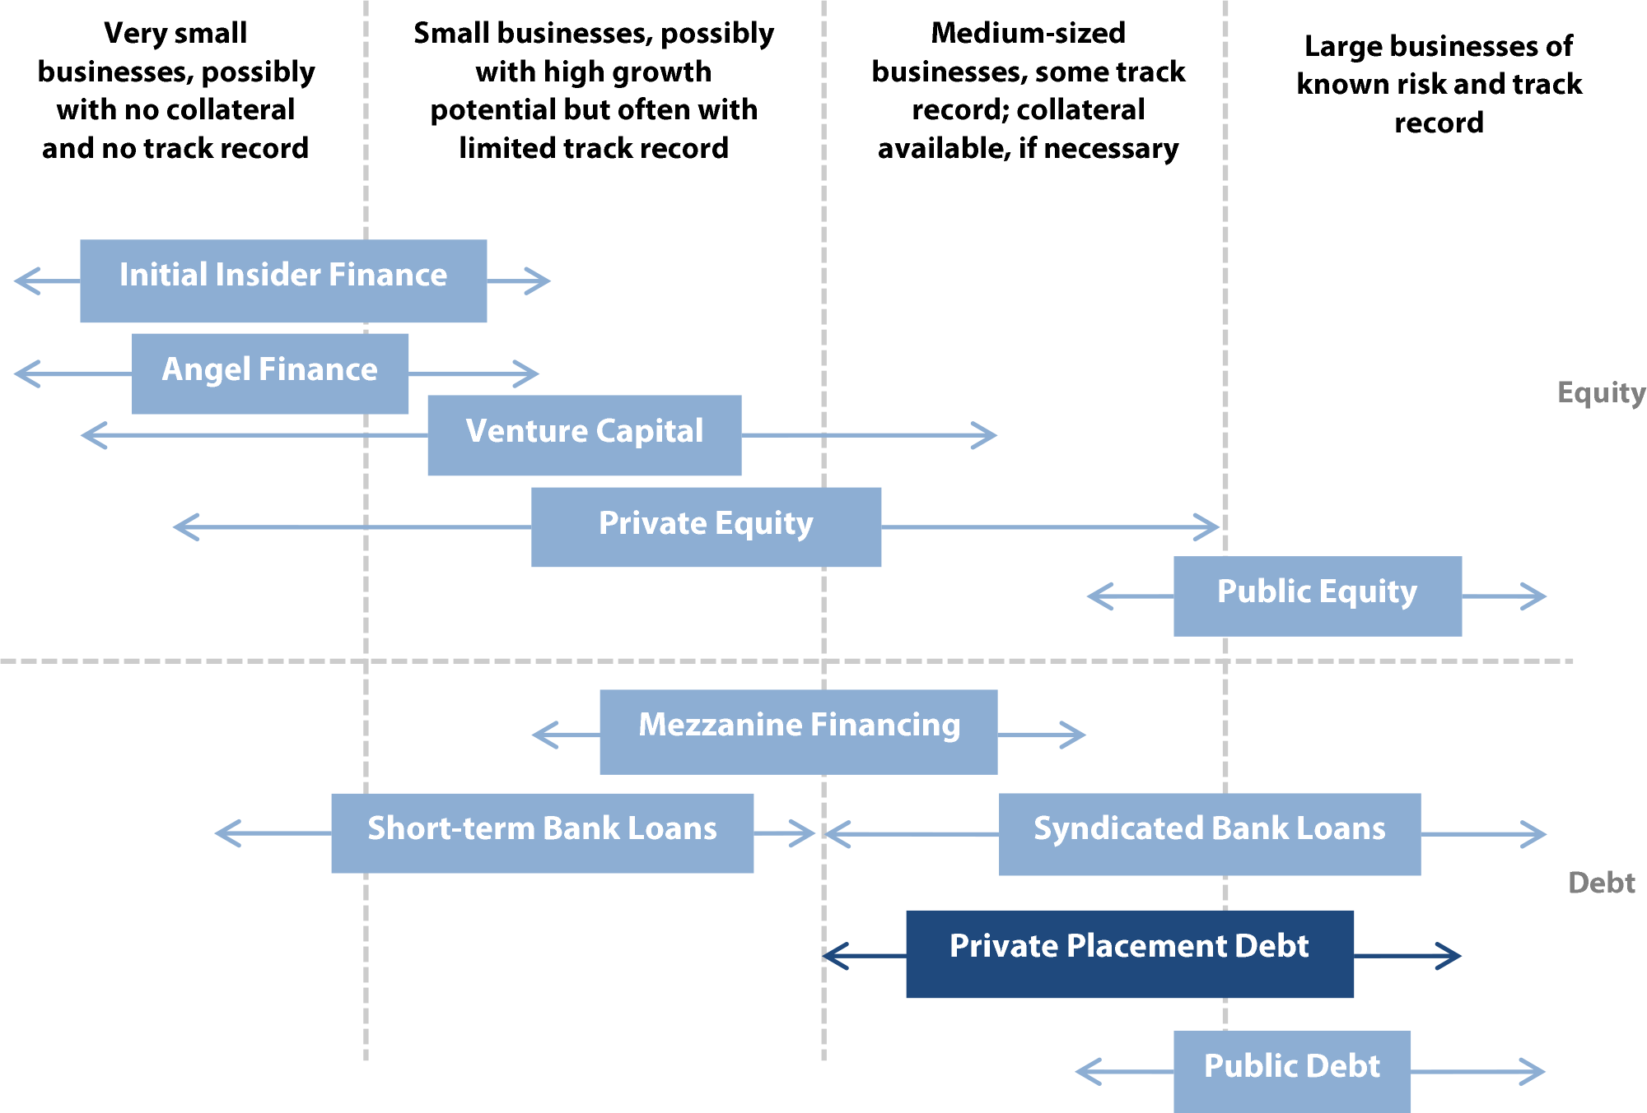
Types of financing available to businesses

Slide 21
Public Issue vs Private Placement
Differences between Public issue and Private placement of securities can be in terms of
Issuing of securities
Disclosure of information and Financial reporting
Transferability of security between investors
Pros and Cons of Public Issue and Private placement

Slide 22
Difference in issuing of securities
Public Issue
Private Placement
Public Issue is a method of selling securities to the public where there are large number of investors
A public issue of securities is underwritten by investment banks, who then make the securities available for sale on the open market.
Public issue is under the regulation by the SEBI
Can be advertised to attract more public investors.
In Private Placement, the company issues its shares directly to a small selected group of investors.
In the case of Private Placement, there is no involvement of mediators since all the dealings are done directly between the issuers and investors.
Cannot be traded in secondary market
No advertisement of offer can be published by the issuer

Slide 23
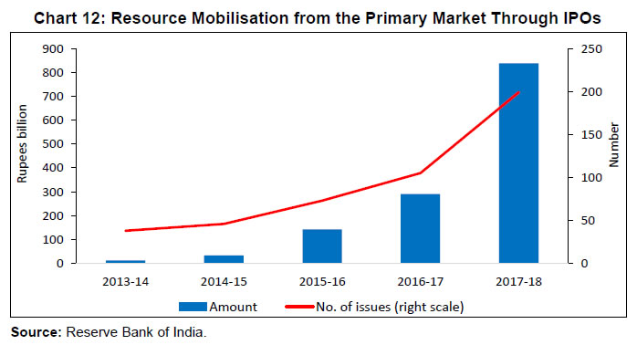
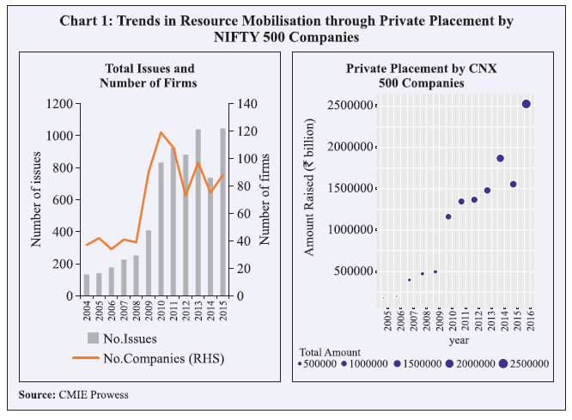

Slide 24
Difference in terms of financial reporting
Public Issue
Private Placement
Detailed financial reporting is necessary once an public offering is issued, and any shareholder must be able to access the company's financial statements at any time. This information should provide enough disclosure to investors so they can make informed investment decisions.
These securities are exempt from many of the financial reporting requirements of public offerings to the general public. So, companies employing this type of financing do not need to comply with the same reporting and disclosure regulations.

Slide 25
Difference in terms of transferability
Public Issue
Private Placement
Publicly issued securities are highly transferable
It enables an easy transfer of ownership as the securities are freely transferable in the secondary market.
In a QIP, the allotted securities are not to be sold by the allottee for a period of one year from the date of allotment, except on the stock exchange.
In the case of a preferential issue, the equity shares and convertible securities allotted are subject to certain conditions and are non-transferable, for a period of three years from the date of trading approval.

Slide 26
Comparing pros: Public and Private placement
Public Issue / IPO
Private Placement
Access to an abundance of capital
Easy transparency and boost value
Increased visibility to market
Liquidity
Freedom to choose investors
Private status is sustained
Flexibility
Ease and speed of Execution

Slide 27
Comparing cons: Public and Private issue
Public Issue / IPO
Private Placement
Lengthy and complex process: The procedure of the Public Issue of shares is time-consuming, lengthy and generally expensive.
Reduced Privacy
External control
Liquidity not available to investors
Small number of investors available for issuer company
Discounted Shares or Higher Returns Requirement by investors

Slide 28
Thank You!

Slide 29
References
https://www.prudentialprivatecapital.com/perspectives/how-to-complete-a-private-placement
https://www.prudentialprivatecapital.com/perspectives/what-is-a-private-placement
https://economictimes.indiatimes.com/markets/stocks/news/hpcl-raises-rs-2000-cr-debt/articleshow/78829765.cms
https://www.livemint.com/news/india/ril-s-jio-sets-a-record-as-pe-funds-pump-in-rs-60-753-crore-11592139436572.html
https://scroll.in/latest/962215/reliance-jio-announces-investment-of-over-rs-6500-crore-by-private-equity-firm-general-atlantic

